Slide 1



AITHON 2.0
Problem Statement Track — EdTech
Problem Statement Title — AdaptEd AI - Personalized Learning Assistant.
Theme — Smart Education.
PS Category — Software
Team Name —SkillMatix. Team ID - TEAM-634
Team Members –
          Rutuja Deshmukh – MET Bhujbal Knowledge City, Institute of Engineering – AIDS - SY
          Rajshree Patil - MET Bhujbal Knowledge City, Institute of Engineering – AIDS - SY
          Aaryan Vispute – KKWIEER – CE - SY
          Utkarsha Nikam – KKWIEER - Robotics & Automation - SY
          Prathamesh Gadakh - Gokhale Education Society's R. H. Sapat College of Engineering – AIDS - SY
@AITHON2.0 Template Submission

Slide 2

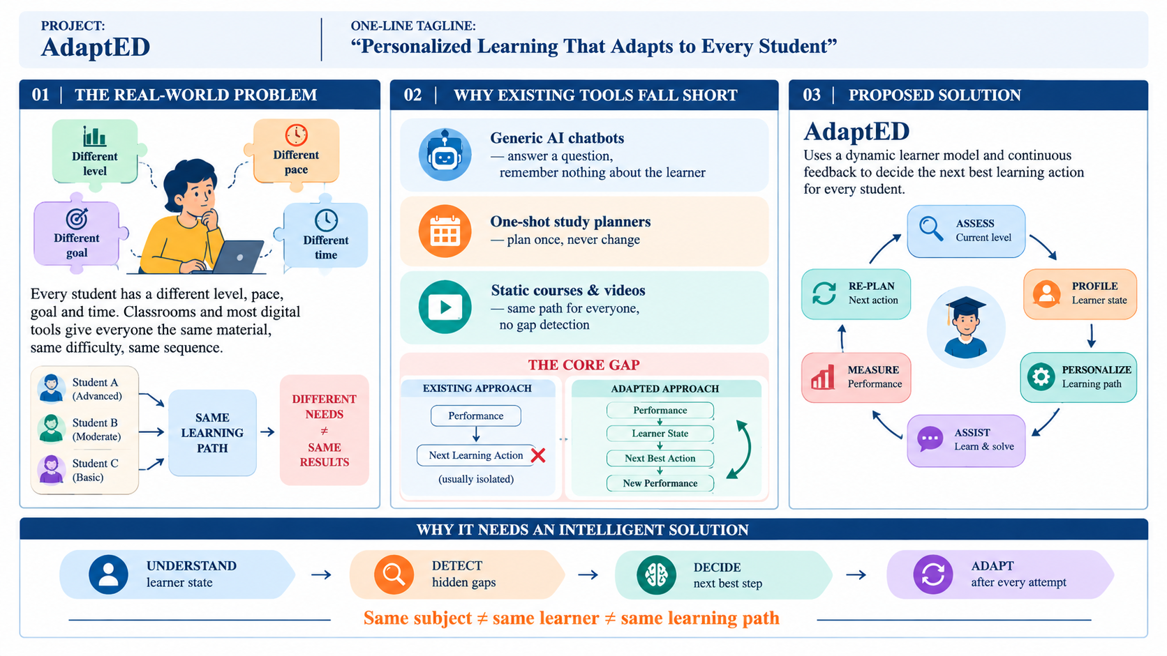
IDEA TITLE
@AITHON2.0 Template Submission

Slide 3
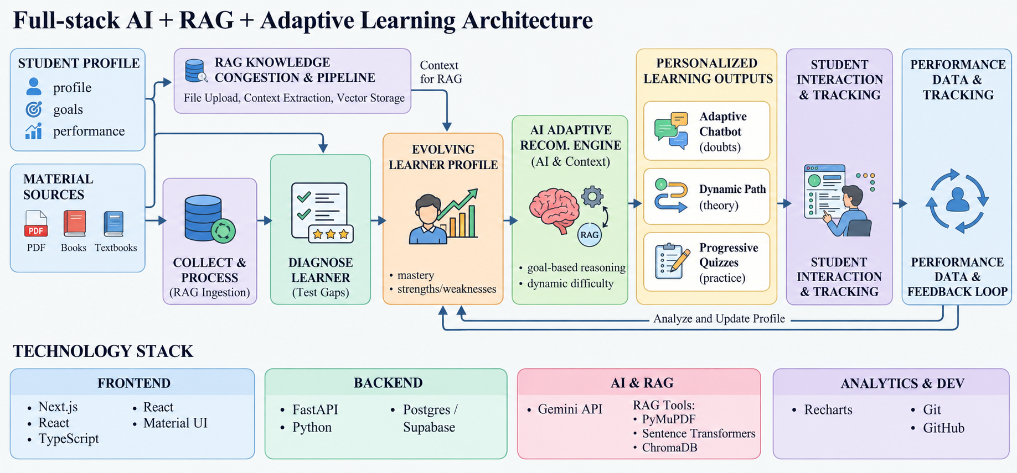
TECHNICAL APPROACH
@AITHON2.0 Template Submission

Slide 4
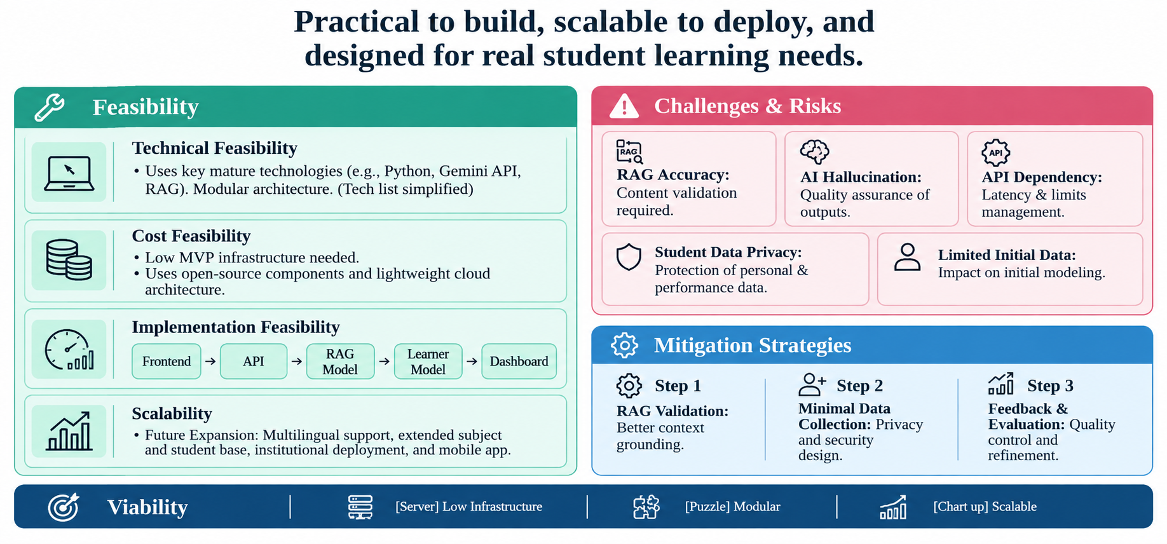
FEASIBILITY AND VIABILITY
@AITHON2.0 Template Submission

Slide 5
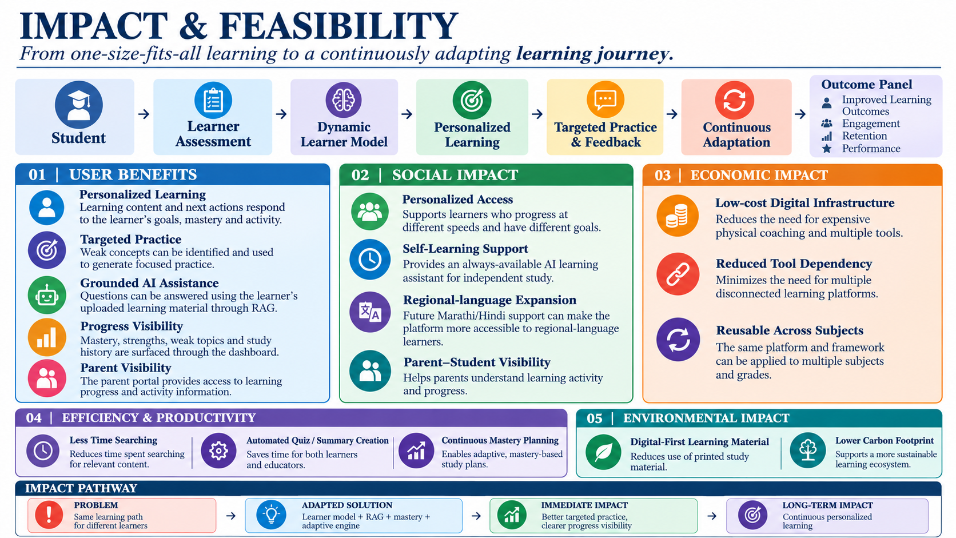
IMPACT AND BENEFITS
@AITHON2.0 Template Submission

Slide 6
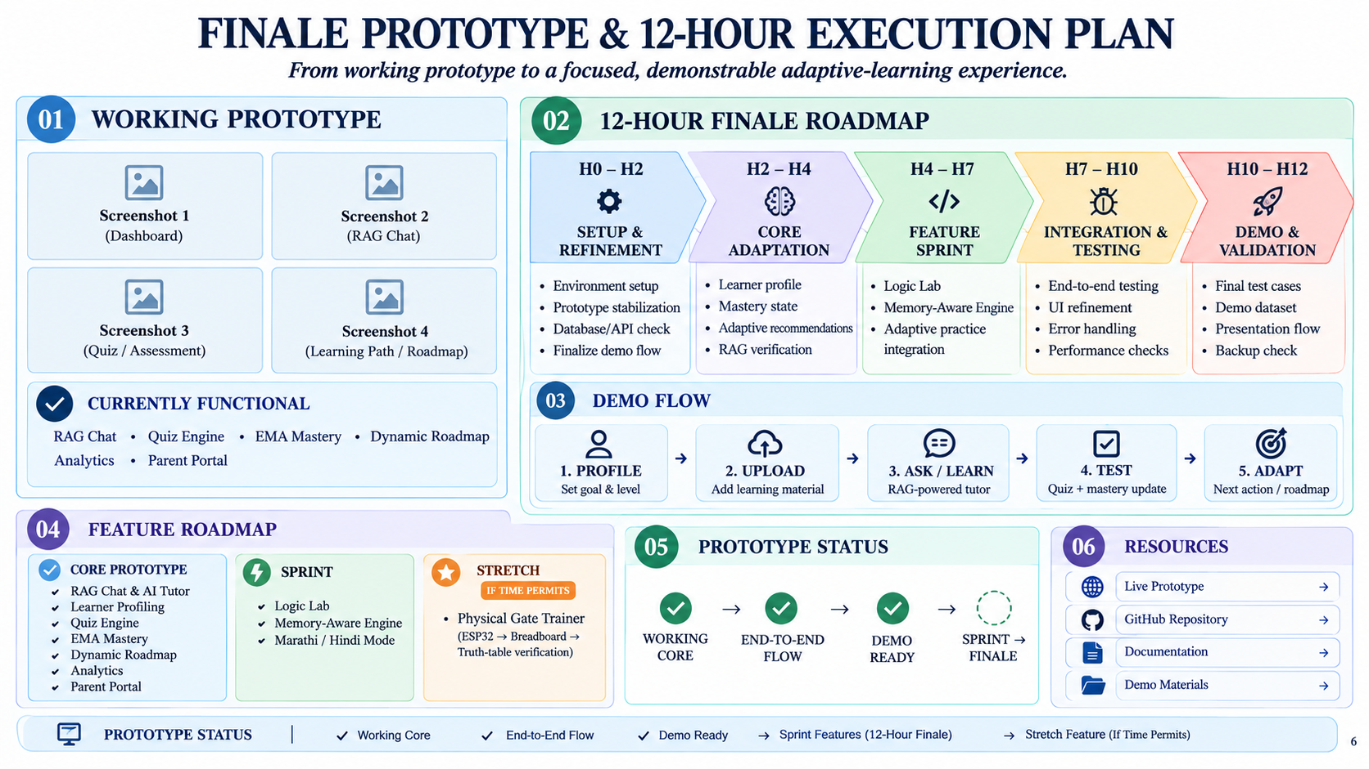
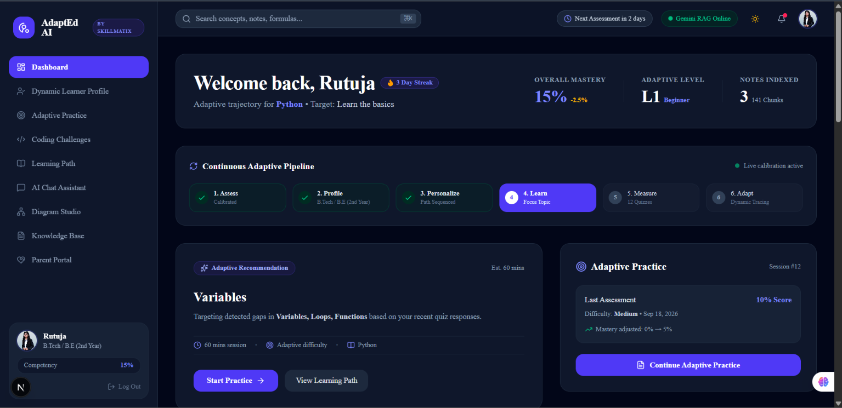
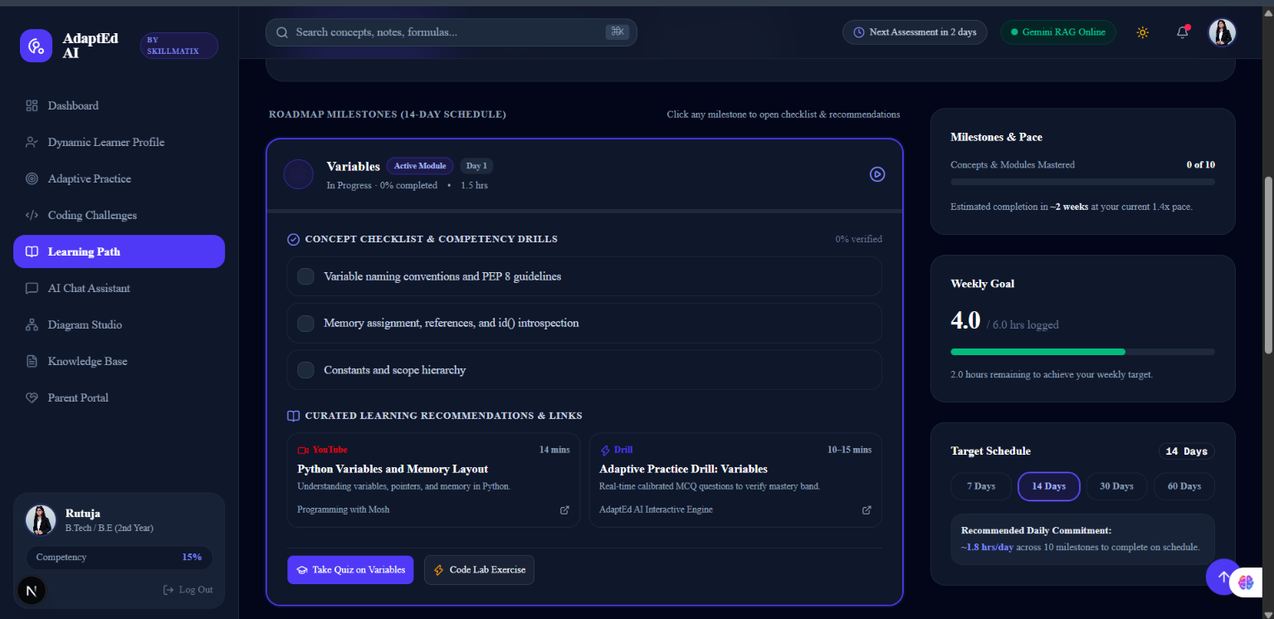
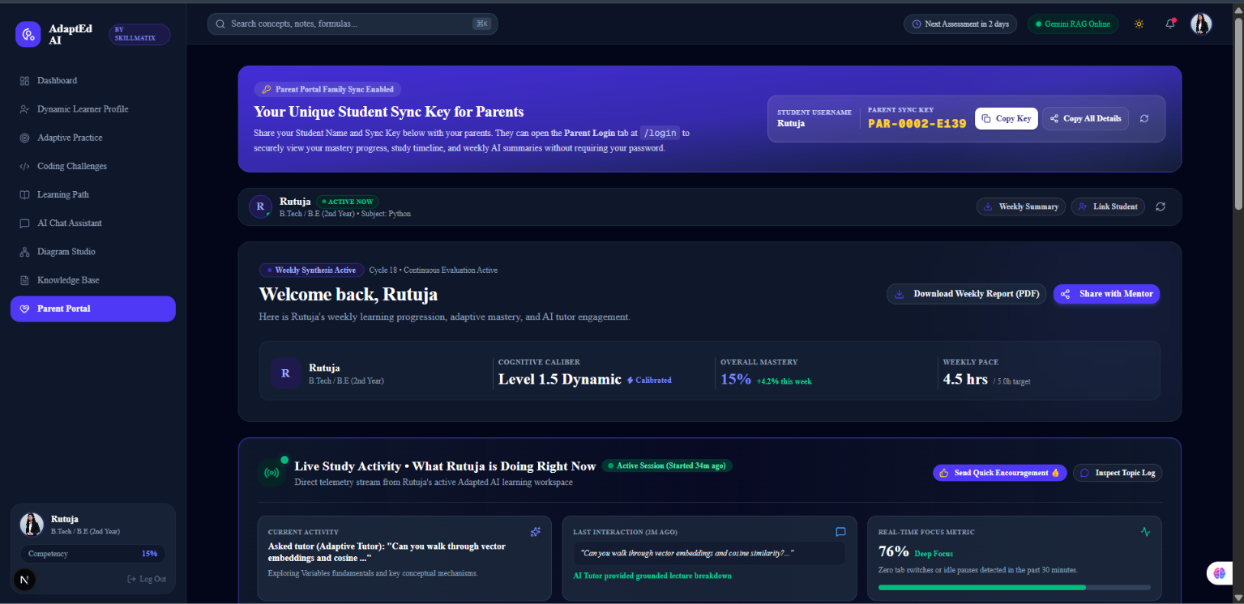
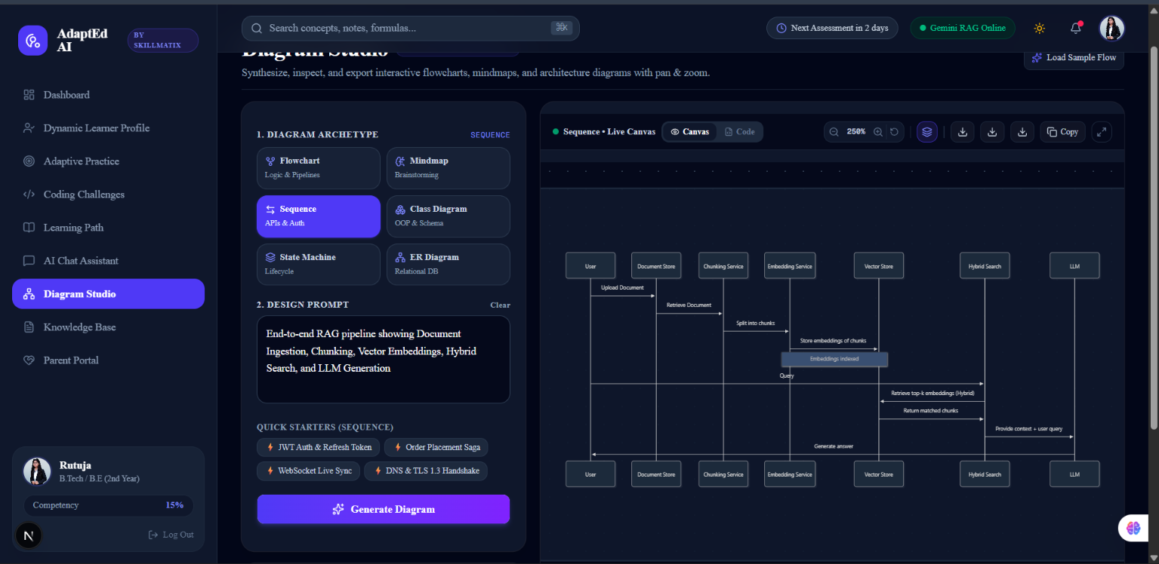
RESEARCH AND REFERENCES
@AITHON2.0 Template Submission

